Slide 1

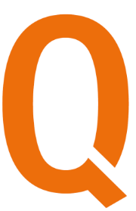

FORMACIÓN QARACTER
REST API – MICROSERVICES – SPRING
ARACTER
BEYOND YOUR CHALLENGE

Slide 2


Formación QARACTER – REST API – MICROSERVICES - SPRING
Presentación
CONTENIDO
REST API
Diferencia entre Microservicio y Monolito
Spring Framework
Estructura básica y Desarrollo
Links
ARACTER
BEYOND YOUR CHALLENGE

Slide 3
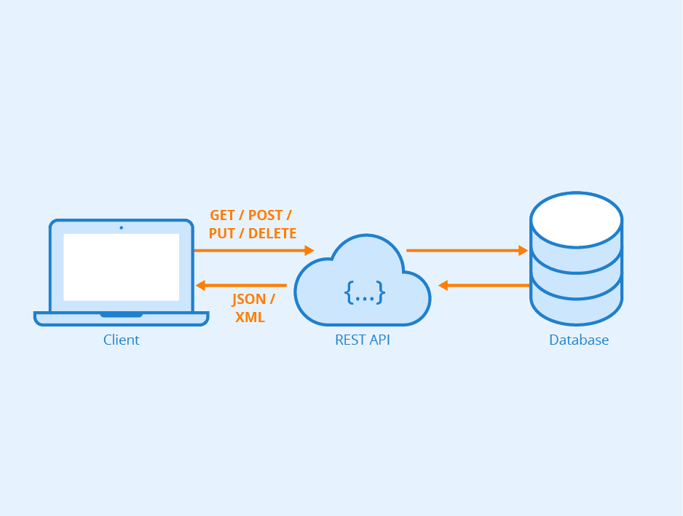
Formación QARACTER – REST API – MICROSERVICES - SPRING
REST API
REST: Representational State Transfer - Transferencia de Estado Representacional
API: Application Programming Interface - Interfaz de programación de aplicaciones
ARACTER
BEYOND YOUR CHALLENGE

Slide 4
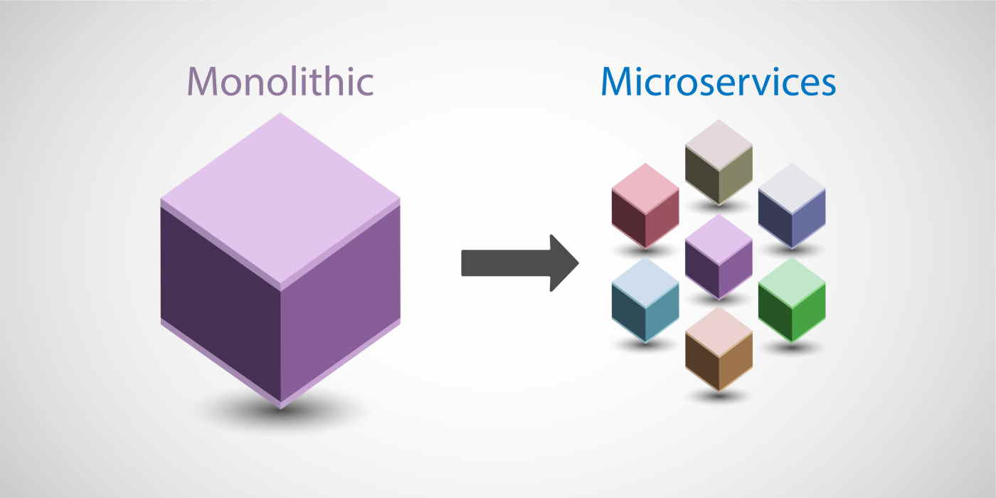
Formación QARACTER – REST API – MICROSERVICES - SPRING
Diferencia entre Microservicio y Monolito
ARACTER
BEYOND YOUR CHALLENGE

Slide 5

Formación QARACTER – REST API – MICROSERVICES - SPRING
Spring Framework
-Spring MVC
-Spring Boot
-Spring Cloud
-Spring Security
-Spring ...
ARACTER
BEYOND YOUR CHALLENGE

Slide 6
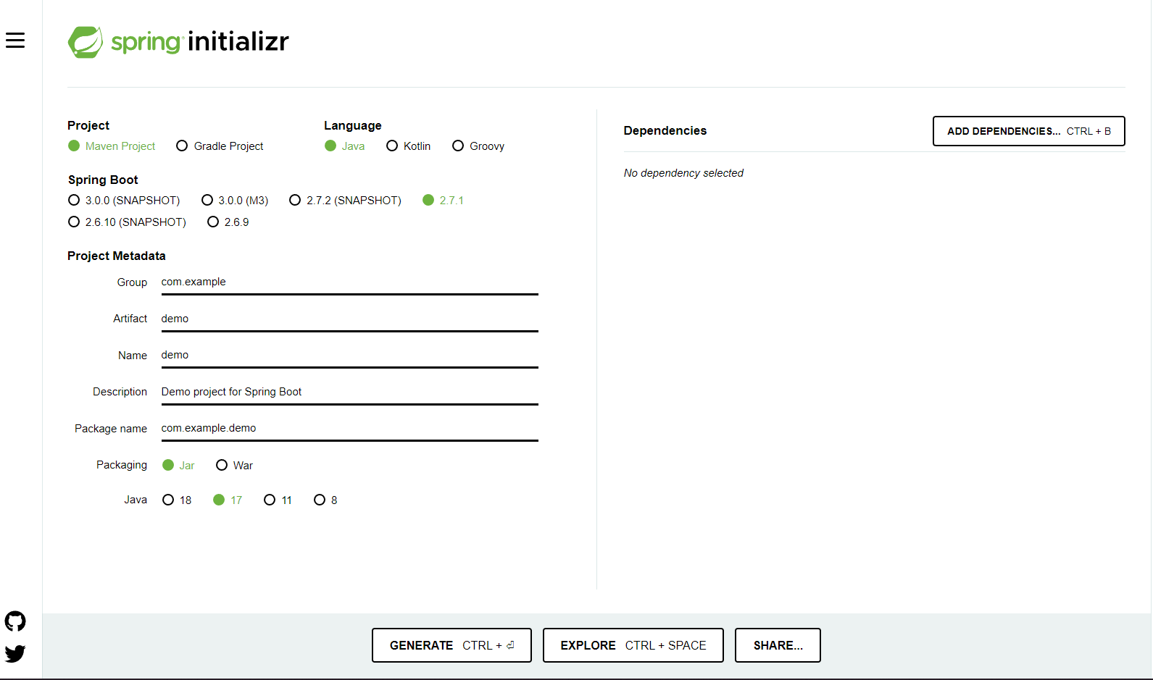
Formación QARACTER – REST API – MICROSERVICES - SPRING
Estructura básica y Desarrollo
https://start.spring.io/
ARACTER
BEYOND YOUR CHALLENGE

Slide 7
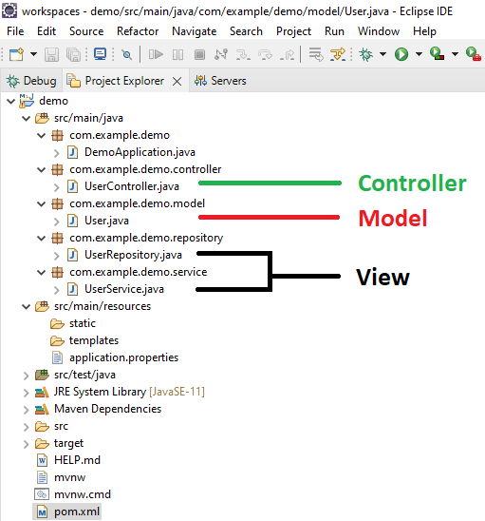
Formación QARACTER – REST API – MICROSERVICES - SPRING
Estructura básica y Desarrollo
ARACTER
BEYOND YOUR CHALLENGE

Slide 8
Formación QARACTER – REST API – MICROSERVICES - SPRING
Links
https://github.com/paulofranklim/spring-boot-crud-sample
https://start.spring.io/
https://spring.io/quickstart
https://docs.spring.io/spring-data/jpa/docs/current/reference/html/#jpa.query-methods.query-creation
https://www.postman.com/
https://wiredelta.com/10-reasons-why-microservices-are-the-future/
https://www.docker.com/resources/what-container/
Spring Cloud, Open Shift o Kubernetes
ARACTER
BEYOND YOUR CHALLENGE

Slide 9
Formación QARACTER – REST API – MICROSERVICES - SPRING
Fin
Muchas gracias!
ARACTER
BEYOND YOUR CHALLENGE

